Slide 1




Continuing Embry-Riddle’s CubeSat Satellite Development Program
Presented by
Clayton G. Jacobs
Embry-Riddle Aeronautical University, Prescott
EagleSat Student Project Manager
Mentor: Dr. Yale

Slide 2
Overview
Background
Timeline
Current Progress
Engineering Model
Challenges
Future Development

Slide 3
Background
ERAU CubeSat Launch Initiative (CSLI) proposal accepted by NASA during Spring 2013 selection period for a 1U form factor.
Primarily student run project.
Subsystem teams exist to delegate tasks and share in the development.
Teams actively recruit students who are interested in getting involved.
Notes:
Student run - Student run project along with multiple faculty mentors with experience in related fields

Slide 4
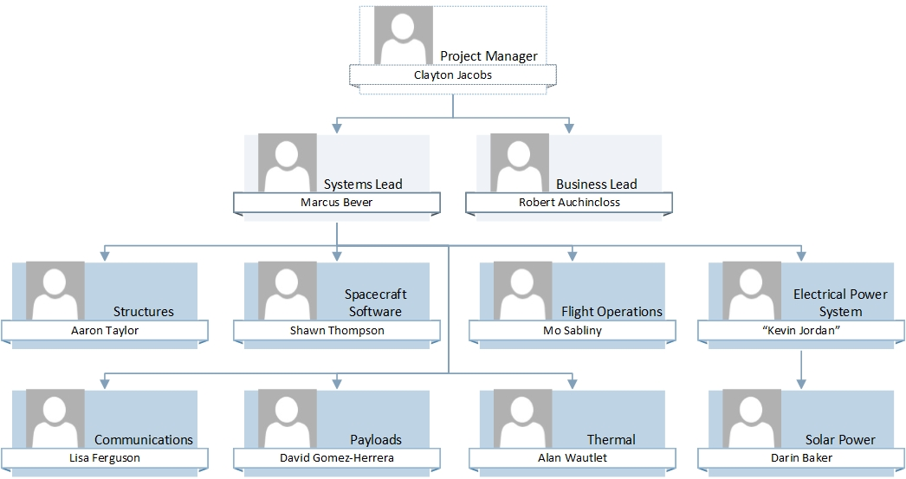
Student Organization Structure
Total Student Members: 34

Slide 5
Background
Program Objective:
  Provide an educational experience for students involved and STEM outreach.
Technical Objectives:
  Testing digital memory technology in space
  Monitoring the de-orbit cycle of the satellite

Slide 6
Timeline
February 2013 – Acceptance from NASA
November 2013 –Preliminary Design Review
Spring 2014 – Engineering Models
August 2014 – HASP 2014
September 2014 – Critical Design Review
April 2015 – Flight Readiness Review
May 2015 – Satellite Delivery
2015/2016 – Launch, Operation

Slide 7
Current Progress
As of Spring 2014, the team has nearly finished their system designs and is beginning to build engineering models to test overall functionality.
The “flat” development kit has been operating the prototype power supply and communications system on custom software for over 28 days of simulated operation.

Slide 8
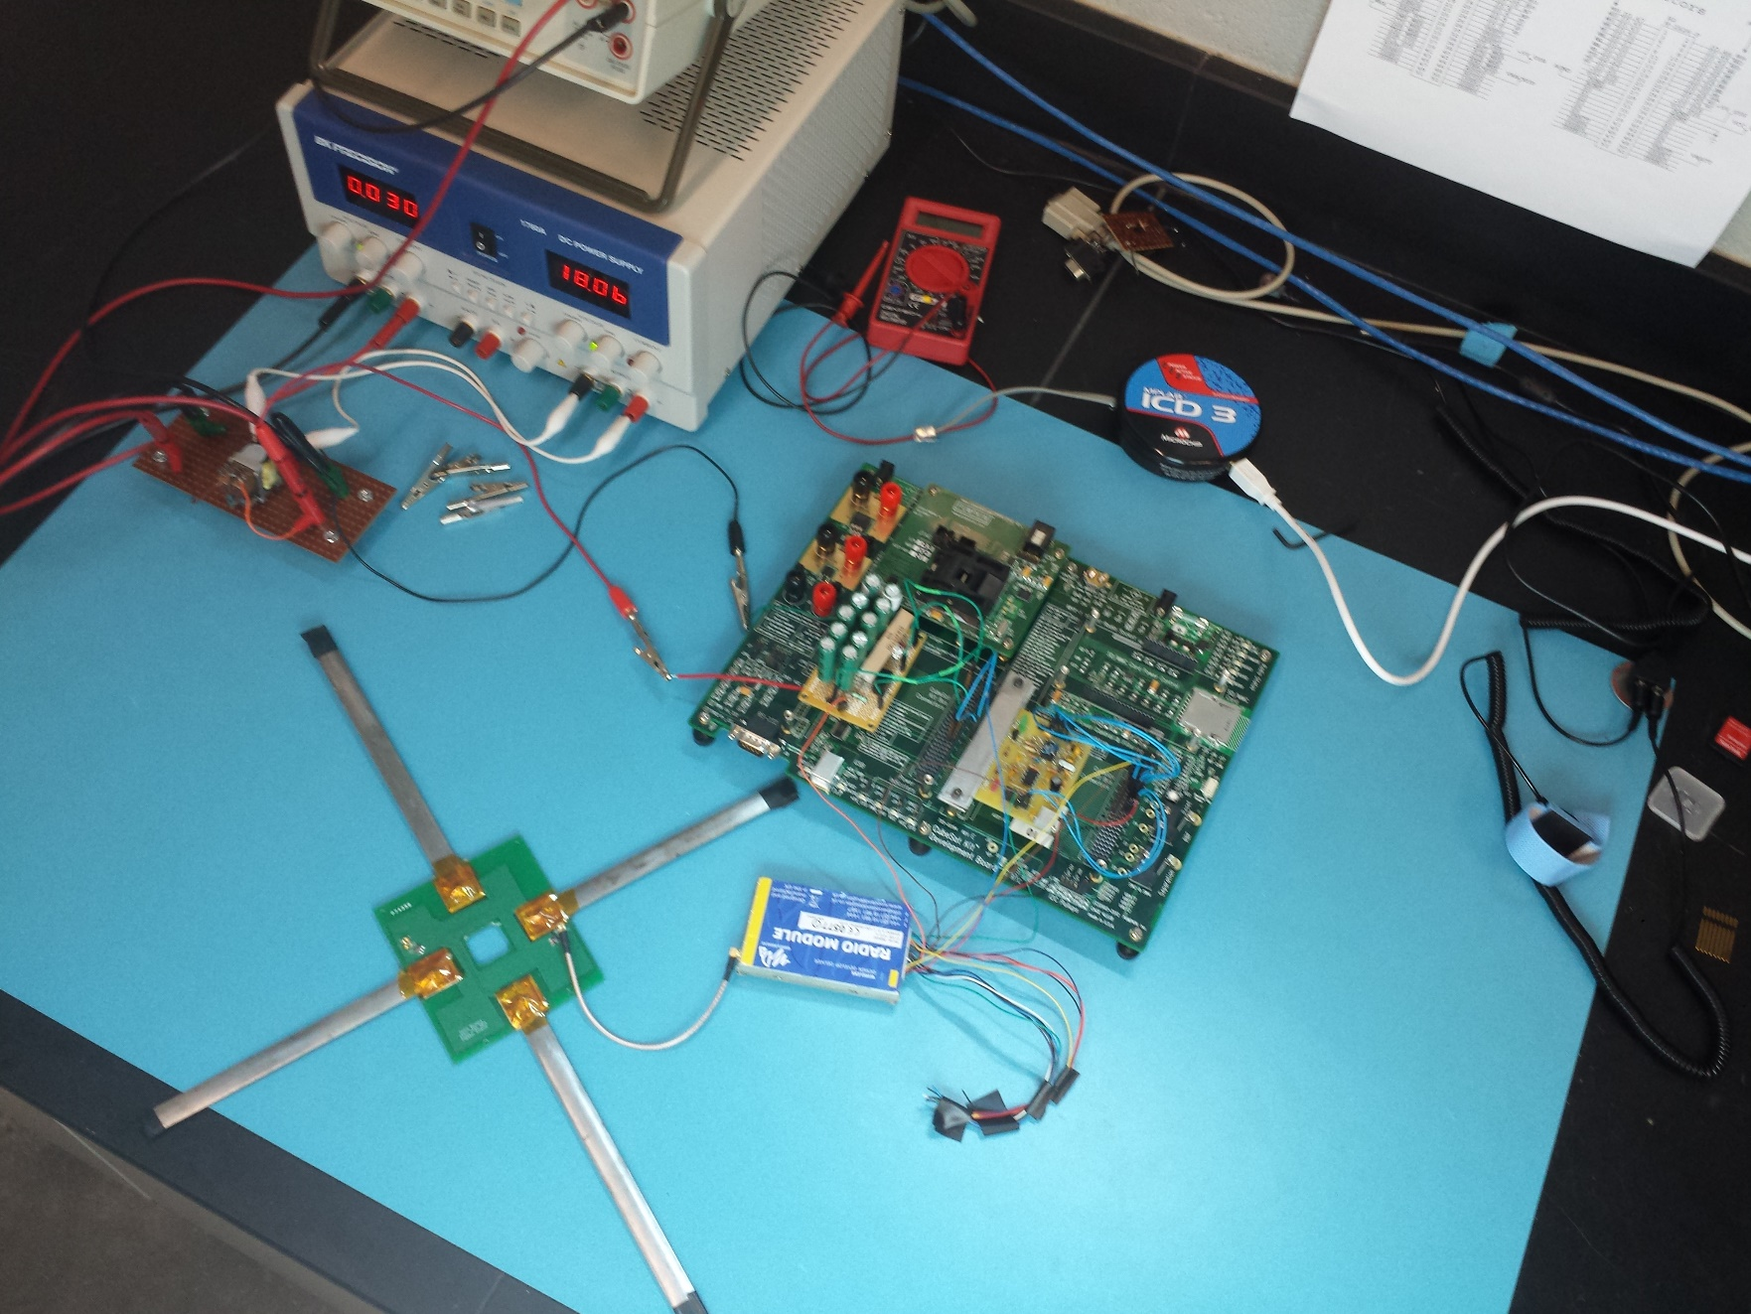
“Flat” Satellite, Development Board

Slide 9
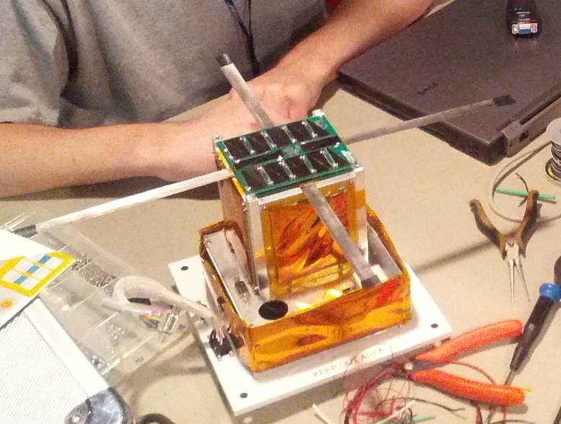
Engineering Model
The complete engineering model is set to fly on an extended high altitude balloon flight in August with NASA HASP.
This test will allow the team to verify satellite functionality in a near space environment for approximately 24 hours.
HASP 2013 Payload

Slide 10
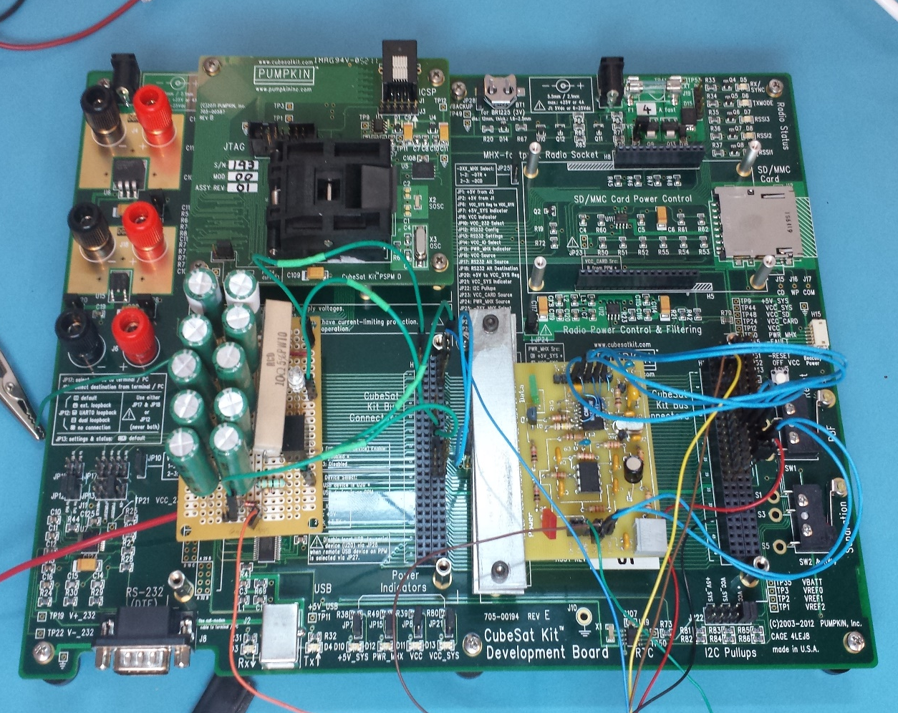
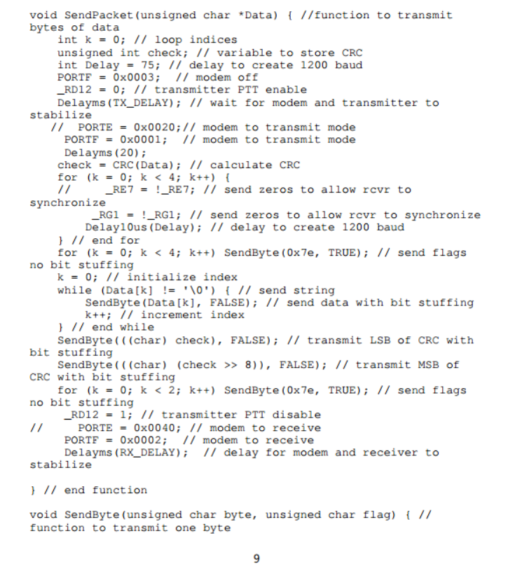
Add Some Pictures
Super Capacitor Power System
Communications Modem and Radio Interface
Sample Code

Slide 11
Challenges
Managing individual and engineering schedules
Balancing engineering/academic workloads
Summer flight preparation for HASP
Long term student retention to prepare for satellite operation
Past experiences with software complexities
Surface mount soldering design and fabrication

Slide 12
Future Development
Results from the balloon flight will indicate if any failures exist in the basic hardware and software design.
The 2014-2015 academic year will include system integration, system testing, and final delivery.
A plan for operations after launch has yet to be created.

Slide 13
Acknowledgements
Dr. Gary Yale, Dr. John Post, and Jack Crabtree
ERAU College of Engineering
Arizona NASA Space Grant Consortium
Dr. Curtis James and the URI Staff
The 2014 EagleSat Student Engineering Team

Slide 14
Thank you for your attention.
Contact:
Clayton G. Jacobs
jacobsc6@my.erau.edu

